Slide 1

Pilihan hati

Slide 2
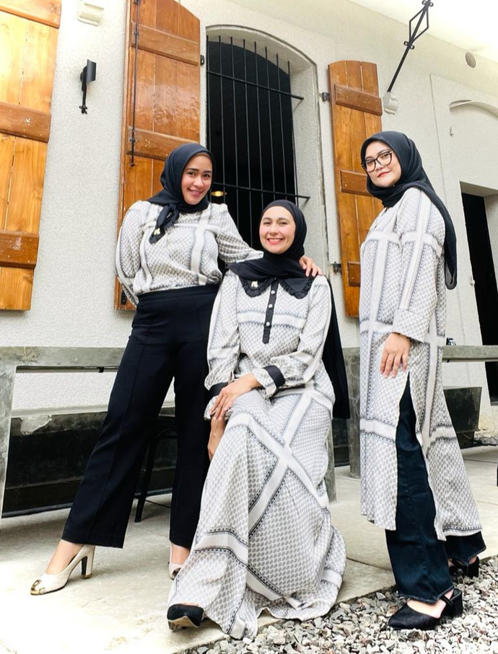
OUR STORY
Pilihan Hati, its all started in October 2022, in Bandung. It was founded by Fitri, Nia and Risa. Pilihan Hati started from a hobby of making, buying and wearing. Then they had friends and relatives that were abandoned by their husbands and family, so the idea coming up to help each other by opening a business.
As time goes by, big dreams and hopes are grow. Dream of having a big brand in Indonesia and hope to be able to help more friends, family and women in particular.
The words "Pilihan Hati" have taken on a true meaning. It emerged with the hope of being able to build a story and brand with an Indonesian name.
Pilihan Hati focuses on daily wear which continues to grow with variants of Muslim clothing products such as dresses, tunics, shirts, t-shirts, culottes and hijabs.
Pilihan Hati theme is quality fabric, comfortable, unique and wearable design.

